Slide 1
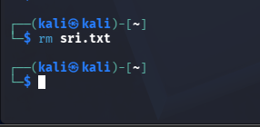

Ethical Hacking
List of Experiments
1. Execute and display the results for the following commands in Kali Linux Operating
Systems:
Rm command:
Users command:
Tree command:

Slide 2
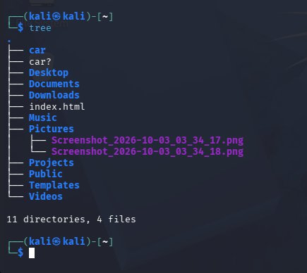
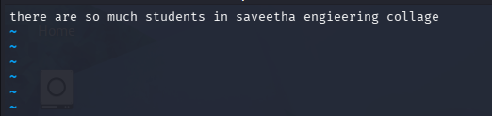
Execute and display the results for the following commands in Kali Linux Operating
Systems:
less command:

Slide 3
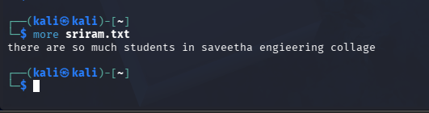
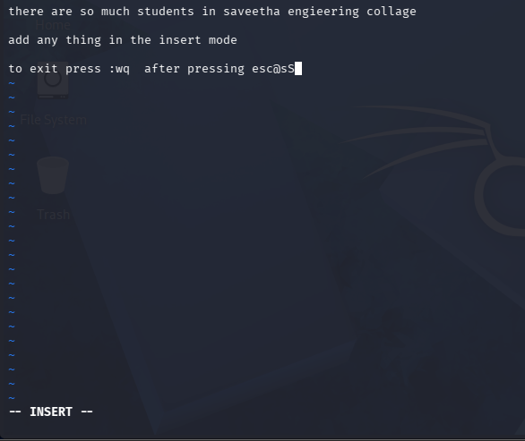
more command
iii. vi command

Slide 4
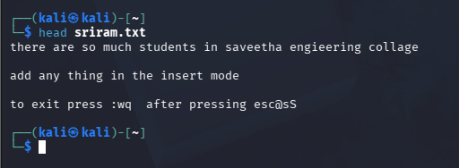
Execute and display the results for the following commands in Kali Linux Operating
Systems:
Tree
ii. Head ##displays the first 10 line

Slide 5
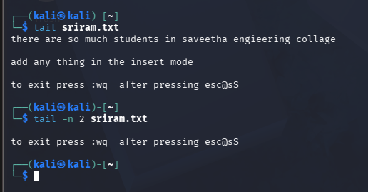

Tail
4. Execute and display the results for the following commands in Kali Linux Operating
Systems:
Ls

Slide 6
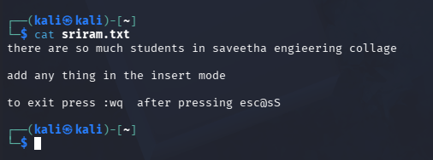

ii) Cat
iii) Mkdir

Slide 7
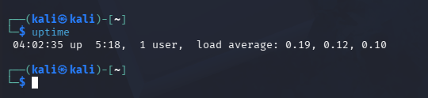
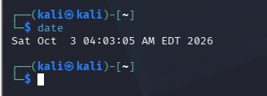
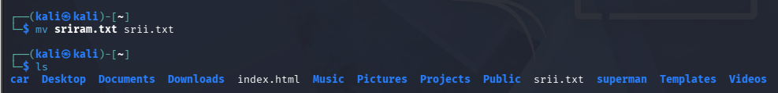
Execute and display the results for the following commands in Kali Linux Operating
Systems:
Uptime
ii) Date:
iii) Mv: ##Move or rename files

Slide 8
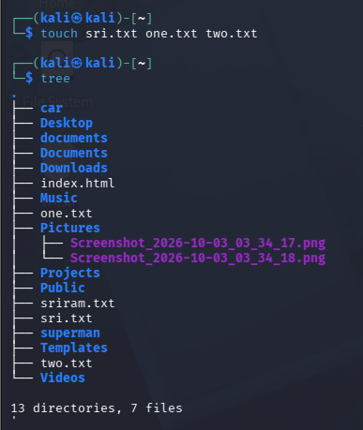

Execute and display the results for the following commands in Kali Linux Operating
Systems:
Touch
ii) Pwd
##pwd means Print Working Directory. It tells you exactly which directory you're currently inside.

Slide 9
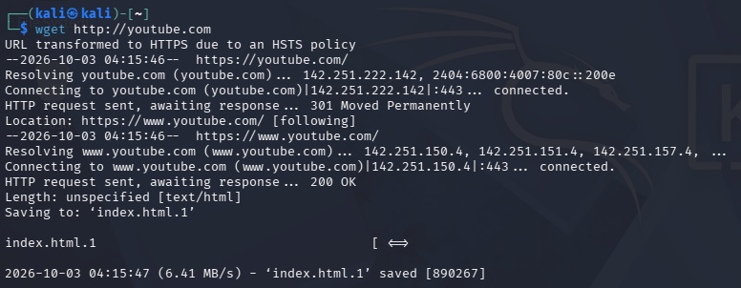

iii) Wget
Execute and display the results for the following commands in Kali Linux Operating
Systems:
Cd

Slide 10
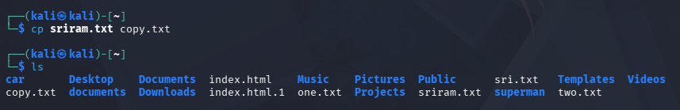

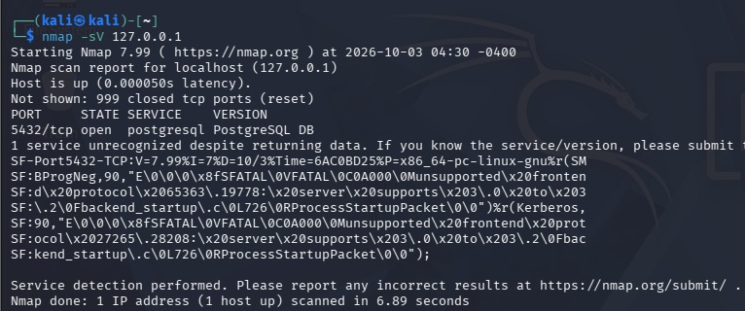
ii. Cp:
Ls
8. Execute and display the results for the following Nmap service version and OS
detection commands in Kali Linux operating systems:
detect the version of services running

Slide 11
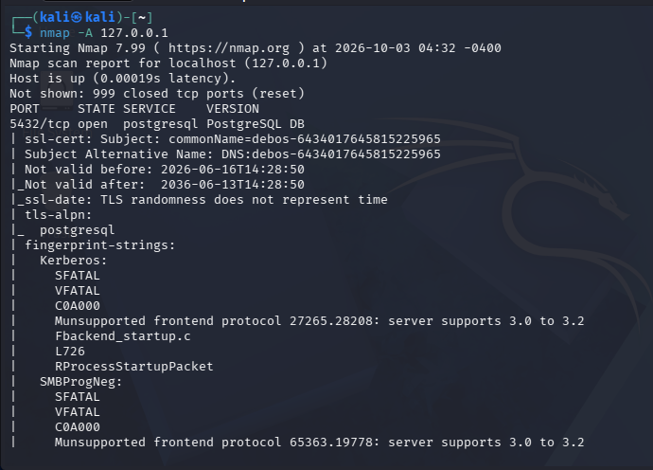
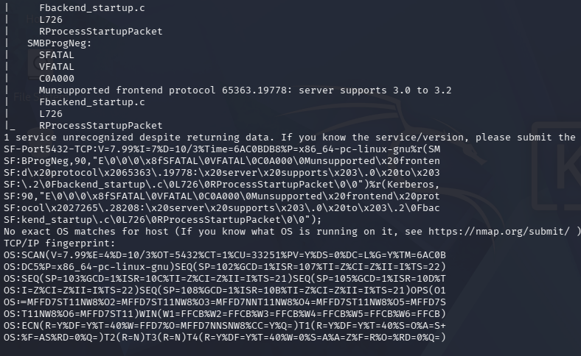
ii) aggressive scan

Slide 12
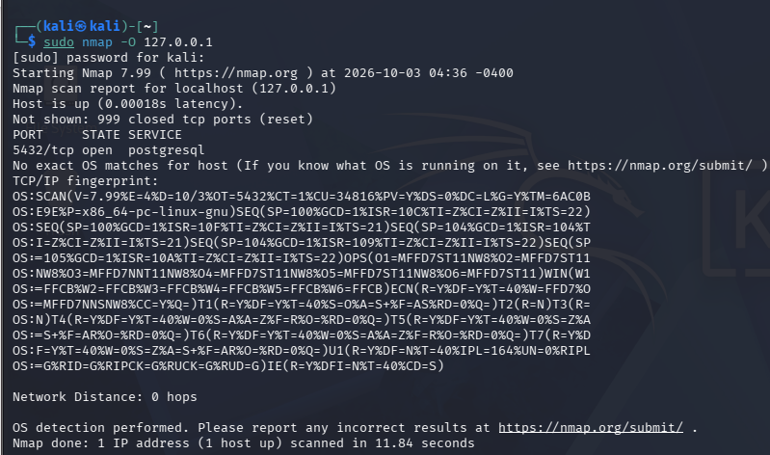
iii) detect operating system of the target

Slide 13
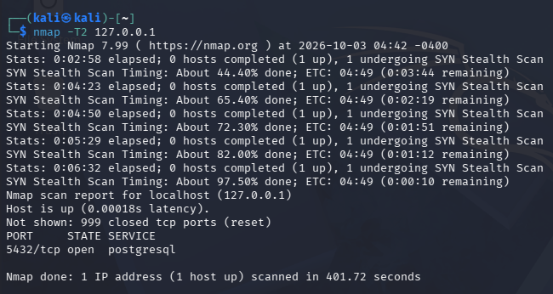
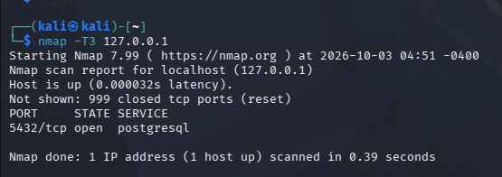
Execute and display the results for the following Nmap Timing and performance
commands in Kali Linux operating Systems:
(i) polite IDS evasion
(ii) normal IDS evasion
Execute and display the results for the following Nmap Timing and performance
commands in Kali Linux operating Systems:
polite IDS evasion:
(ii) normal IDS evasion

Slide 14
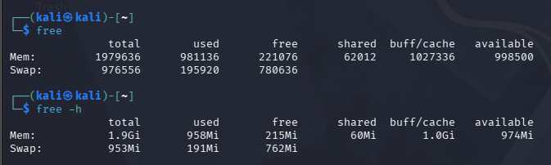
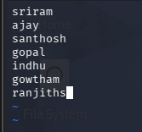
10. To execute the following commands in Kali Linux Operating Systems:
Free command
Sort command:
##inside the file before sorting

Slide 15
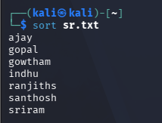
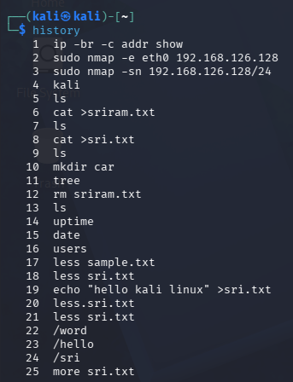
iii. History command

Slide 16
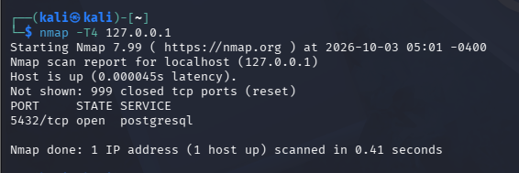
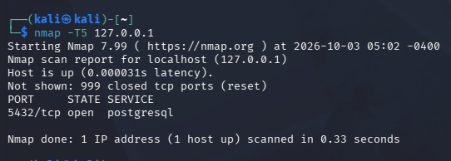
11. Execute and display the results for the following Nmap Timing and performance
commands in Kali Linux operating Systems:
aggressive speed scan:
(ii) insane speed scan

